Slide 1

WISE Consulting
October 17, 2002
Winning
Integration
Strategies for
Expatriates

Slide 2
Situational Overview
Us: WISE Management and H.R. Consulting
Audience: H.R. Management Team, Argos Diesel, Inc.
Purpose: WISE Consulting has been hired by Argos to provide recommendations on multi-cultural issues related to expatriate performance

Slide 3
WISE Consulting
October 17, 2002
Eric Jordan
Consulting Analyst
Jared J. Rodriguez
Strategic Analyst
So-young CHUNG
Organizational Behavior Strategist
Karthik Ramachandran
Director, Consulting

Slide 4

Agenda
Who We Are
Why Are We Here
Our Methodology/Process
Recommendation
Success Stories
Conclusion

Slide 5
Who We Are
Over 20 years experience
“Multinational Business Partnership Award of Excellence”
Consulting services to over 50 Fortune 500 companies
Who we are
Why are we here
Methodology
Recommendation
Success Stories
Conclusion
Questions?

Slide 6
WISE Consulting
October 17, 2002
Eric Jordan
WISE Consulting Analyst

Slide 7
Why Are We Here
Who we are
Description of Problem: morale and performance of top executives affected by multicultural issues:
  Language
  Etiquette
  Organizational Differences in Work Culture
Why are we here
Methodology
Recommendation
Success Stories
Conclusion
Questions?
Notes:
Thank you, Karthik… As Karthik indicated, I would like to share with you what brings us to the table today. Within the past 6 -12 months, Argos Diesel HQ’s has identified a few major problems with the performance and morale of some of its top performing executives while on expatriate assignments, particularly related to multicultural issues. Argos hired us to examine, analyze and provide suggestions on how to address this problem. Specifically, we focused our analysis around 3 areas:
Language
Etiquette
Organizational differences in work culture
In the next few slides, I will define each of these in more detail…

Slide 8
Language
By choosing not to learn, expatriates communicate that they are:
  Uninterested
  Ethnocentric
  Incompetent
  Disrespectful
NOT A TEAM-PLAYER
Who we are
Why are we here
Methodology
Recommendation
Success Stories
Conclusion
Questions?
Notes:
Although learning and communicating the local language is not a requirement for expatriates on assignment, it can be source for conflict. Expatriates who choose not to learn a local language come across as :
Not interested or feel there is no need
Arrogant (Having a superiority complex)
Closed-minded, or unable to learn
Disrespectful
Essentially, the unlearned expatriate is conveying that they are not a team player.

Slide 9
Etiquette
Cultural nuances and idiosyncrasies
Dress codes
Codes of conduct
(social gatherings, food, etc.)
How to repair any potential damages
Who we are
Why are we here
Methodology
Recommendation
Success Stories
Conclusion
Questions?
Notes:
The foundation underlying etiquette is respect… Respect for your colleagues, and respect for the local customs, culture and environment. These include familiarity with:

Slide 10
Organizational Differences in Work Culture
Leadership styles (MBWA)
Job titles and descriptions
Meeting management
Cultural conceptions of time (workday hours)
Who we are
Why are we here
Methodology
Recommendation
Success Stories
Conclusion
Questions?
Notes:
Probably the greatest multi-cultural barrier that affects expatriate performance is the understanding, or lack thereof, of organizational differences in work culture. These differences can be illustrated through:

Slide 11
Our Methodology
Who we are
40 Expatriate Interviews
250 Surveys
15 Focus groups:
  Executive assistants
  H.R. managers
  Top executives
Why are we here
Methodology
Recommendation
Success Stories
Conclusion
Questions?
Notes:
Now that I have set the table, so to speak, on the issues that we have addressed, let me (allow me to) walk through our process for analyzing the problem, and how we developed our recommendations.
First we started by interviewing both past and present executives with expatriate experience (40 one-on-one interviews in total).
Second, we conducted over 250 surveys (both telephone and paper-based) with representatives from each of Argos Diesel’s non-U.S. locations
Finally, we coordinated 15 focus groups with employees from the following category's:
Next, I’d like to introduce Jared Rodriguez, Strategic Analyst, who will describe our recommendations.

Slide 12
WISE Consulting
October 17, 2002
Jared J.Rodriguez
Strategic Analyst

Slide 13
Recommendation
Based on the company’s need to:
Develop top talent
- International skills
- Aligned strategies
- Communication
Who we are
Why are we here
Methodology
Recommendation
Success Stories
Conclusion
Questions?

Slide 14
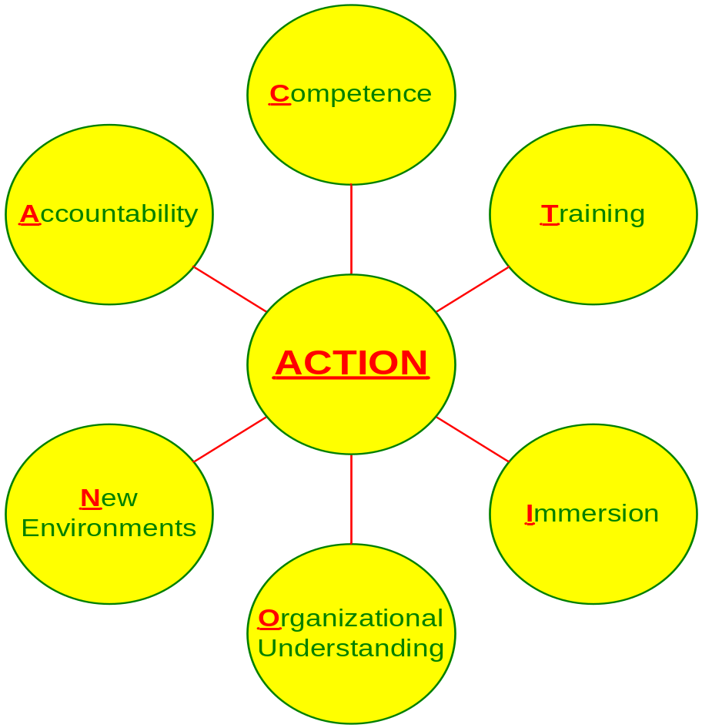
Recommendation
Who we are
Why are we here
Methodology
Recommendation
Success Stories
Conclusion
Questions?

Slide 15
Recommendation
3 Step Development Training Program
Precision training
High impact training
Success measurement
Who we are
Why are we here
Methodology
Recommendation
Success Stories
Conclusion
Questions?

Slide 16
1. Precision Training
Assignments of two months
or less
- Lectures
- Videos on cultural etiquette
- Survival language kit
Who we are
Why are we here
Methodology
Recommendation
Success Stories
Conclusion
Questions?

Slide 17
2. High Impact Training
Assignments of more than
Two months
- Field Trip
- Simulations and case studies
- Family integration modules
Who we are
Why are we here
Methodology
Recommendation
Success Stories
Conclusion
Questions?

Slide 18
3. Success Measurement
Administered for all assignments
- Quarterly evaluations
- Interviews
- Surveys
Who we are
Why are we here
Methodology
Recommendation
Success Stories
Conclusion
Questions?

Slide 19
WISE Consulting
October 17, 2002
So-young CHUNG
Organizational Behavior Strategist

Slide 20
Success Stories
Costly Failure Experiences
Johnson & Johnson
AT&T
Gillette
Who we are
Why are we here
Methodology
Recommendation
Success Stories
Conclusion
Questions?

Slide 21

Success Stories
Johnson & Johnson :
Standard Training Program
Who we are
Why are we here
Methodology
Recommendation
Success Stories
Conclusion
Questions?

Slide 22

Success Stories
AT&T :
Innovative Mentoring Program
Who we are
Why are we here
Methodology
Recommendation
Success Stories
Conclusion
Questions?

Slide 23

Success Stories
Gillette :
18-month international-trainee program
Who we are
Why are we here
Methodology
Recommendation
Success Stories
Conclusion
Questions?

Slide 24
Conclusion
Who we are
Morale and performance
Three-step Development Training Program
Success Examples
Why are we here
Methodology
Recommendation
Success Stories
Conclusion
Questions?

Slide 25
Questions ?

Slide 26
Closing Remarks
Accountability
Competence
Training
Immersion
Organizational Understanding
New Environments

Slide 27

WISE Consulting
October 17, 2002
Thank
You !

